Slide 1

What is Microsoft 365?
Module 1 – Lesson 1

Slide 2

objectives
In this module, you will:
List the capabilities of Microsoft 365
Understand the value provided by Microsoft 365 solutions
Name the Microsoft 365 subscription options
Create a Microsoft 365 trial organization
Explore the Microsoft 365 Fundamental exam study areas and learning paths

Slide 3
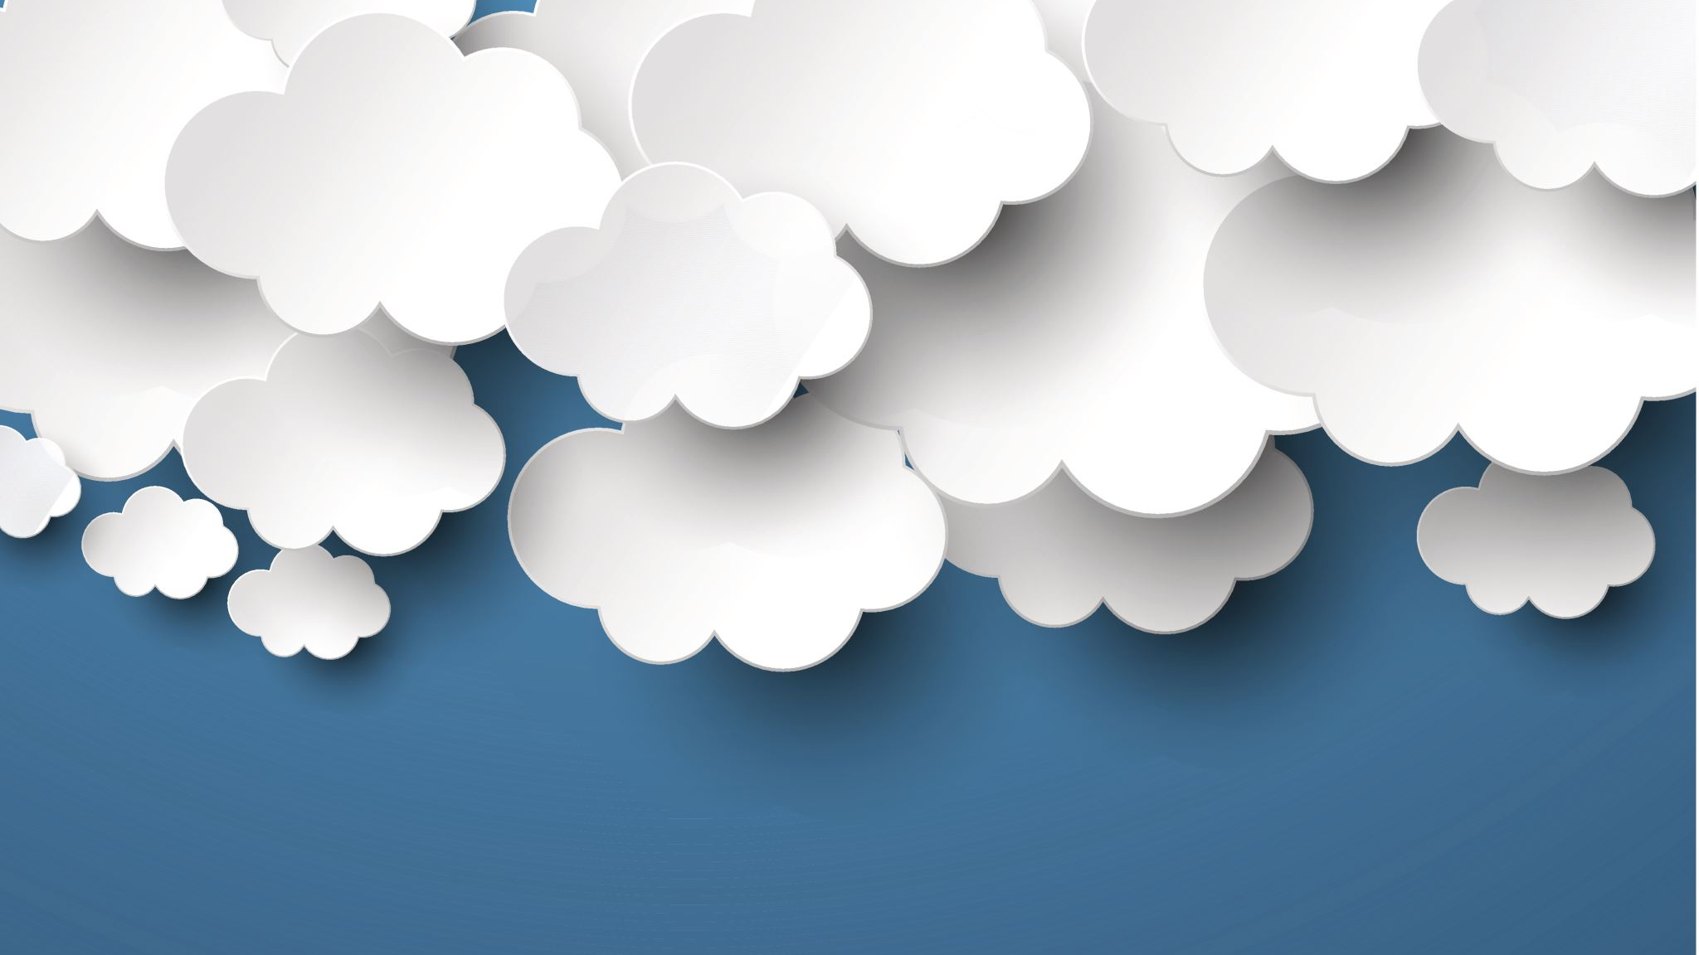
Prerequisites
Basic understanding of cloud computing.

Slide 4
What is Microsoft 365?
Software-as-a-Service (SaaS) model
Notes:
Microsoft 365 empowers users with the latest innovation across new and familiar productivity experiences like Teams, Word, Excel, PowerPoint, Outlook, and Windows. Unlike other productivity services, Microsoft 365 learns from users and collects valuable insights through the Microsoft Graph to deliver enhanced experiences that continually get better over time and keep users protected. Microsoft 365 empowers organizations with the following capabilities:
Some Microsoft 365 components, like Microsoft 365 Apps and Windows, are delivered using the Software-as-a-Service (SaaS) model. SaaS is software that’s centrally hosted and managed by a cloud service provider (CSP) for customers. In general, CSPs provide one version of an app for all customers and license it through a monthly or annual subscription.

Slide 5
Microsoft 365
Microsoft 365 learns from users
collects insights through the Microsoft Graph
Used to enhanced User experiences get better thru utilization
keeps users protected.
Microsoft 365 empowers organizations with the following capabilities:
Productivity and Teamwork
Business Management
Security and Compliance
Notes:
Productivity and Teamwork
Includes instant messaging and online meetings with Microsoft Teams, email and calendaring with Outlook, familiar Office apps on all devices, advanced file storage and sharing with OneDrive, intranet and team sites, and enterprise social networks with Yammer.
Business Management
Includes simplified IT management with Microsoft Endpoint Manager, business process automation, extensibility with Teams and Power Platform, business voice and phone system with Teams, Forms and workflow management, business intelligence with Workplace Analytics, and work management with Project Online.
Security and Compliance
Includes solutions for identity and access management, information protection and governance, threat protection, security management, insider risk management, compliance management, and eDiscovery.

Slide 6
Module's goal
In this module, you will:
List the capabilities of Microsoft 365
Understand the value provided by Microsoft 365 solutions
Name the Microsoft 365 subscription options
Create a Microsoft 365 trial organization
Explore the Microsoft 365 Fundamental exam study areas and learning paths

Slide 7

productivity benefits of Microsoft 365
Personal productivity
Enable teamwork and simplify workflow
Stay productive on the go
Get more done with AI-enabled tools
Organizational productivity
Harness organizational knowledge
Manage all your endpoints
Protect your business
Notes:
Personal productivity
Microsoft 365 provides powerful capabilities through AI powered tools to unleash your organization's creativity and fuel innovation. From engaging presentations to animated 3D models and immersive mixed reality experiences, you can now create high-quality content that really stands out. AI-powered tools help you turn an ever-growing mass of data into actionable insights to transform your organization. Stay focused with fewer distractions and easily access the people and information you need without leaving the flow of your work. When inspiration strikes, effortlessly go from thought to content using voice, touch, and pen on any device.
Enable teamwork and simplify workflow
Collaborate, meet, call, and connect business applications all in one place with Microsoft Teams.
Stay productive on the go
Easily transition from computer to mobile devices with innovative and powerful mobile apps.
Get more done with AI-enabled tools
Fuel creativity, discover new insights, elevate search and get personalized assistance with built-in intelligence features.
Organizational productivity
Organizations are always seeking to stay competitive in an ever-changing commercial landscape. They want to drive top-line growth, cut costs and better serve their customers. They want to unlock the potential of their employees, drive process automation, capture the collective knowledge of their organization, and avoid potential security, compliance or privacy risks that may derail progress.
Harness organizational knowledge
Quickly turn data into insights and empower employees with the information and expertise they need to get their work done with Workplace Analytics.
Manage all your endpoints
Deploy a seamless, end-to-end management solution and gain visibility across all connected devices with Microsoft Endpoint Manager.
Protect your business
Elevate and modernize your security, manage risk, and meet compliance standards on Microsoft's trusted cloud.

Slide 8
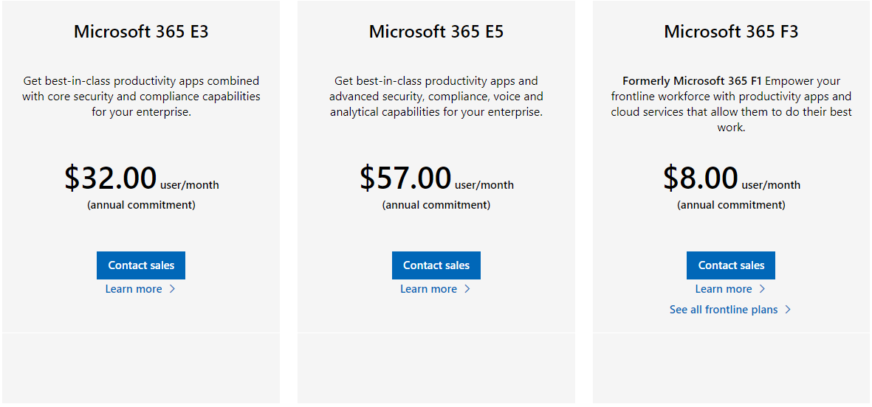
Microsoft 365 subscription options
Microsoft 365 Enterprise
Microsoft 365 for business
Microsoft Education
Microsoft Government
Microsoft Home
Notes:
Microsoft 365 Enterprise
Microsoft 365 Enterprise provides enterprise-class services to organizations that want a productivity solution that includes robust threat protection, security, compliance, and analytics features.
There are three available plans for Microsoft 365 Enterprise, letting you further refine what's included in your implementation - E3, E5, and F3 (formerly F1). E5 includes all of the same features as E3 plus the latest advanced threat protection, security, and collaboration tools. F3 is designed for Firstline Workers through purpose-built tools and resources that allow them to do their best work.
You can compare the enterprise plans to see which fits based on your specific needs.

Slide 9
Microsoft 365 tenant
Notes:
Explore Microsoft 365 tenant
Completed100 XP
5 minutes
Microsoft offers free trials for many different services, and you can sign-up for a free 30-day Microsoft 365 Business Premium subscription at the links below. Your free trial includes up to 25 users. Experience how Microsoft 365 empowers employees to create their best work, simplifies business processes, and helps protect users, data, and customer information.

Slide 10
Knowledge check
Which of the following Microsoft 365 subscription option is appropriate for companies with under 300 employees?
Microsoft 365 Enterprise
Microsoft 365 for business
Microsoft 365 Education
Which of the following are included in Microsoft 365 Enterprise E5, but not in Microsoft Enterprise E3?
More user licenses
Localized versions
Advanced threat protection, security, and collaboration tools
Microsoft Endpoint Manager is part of which capability of Microsoft 365?
Productivity and Teamwork
Business Management
Security and Compliance
Notes:
B
C
B

Slide 11
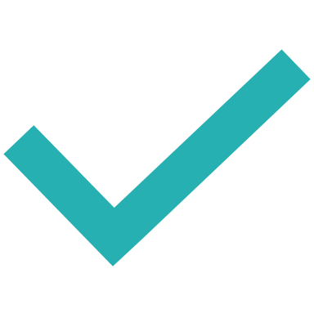
Summary and resources
Now that you've reviewed this module, you should be able to:
List the capabilities of Microsoft 365
Understand the value provided by Microsoft 365 solutions
Name the Microsoft 365 subscription options
Create a Microsoft 365 trial organization
Explore the Microsoft 365 Fundamental exam study areas and learning paths
Notes:
In this module you learned that productivity cloud that delivers innovative and intelligent experiences, rich organizational insights and a trusted platform to help people and organizations get more done.
Now that you've reviewed this module, you should be able to:
List the capabilities of Microsoft 365
Understand the value provided by Microsoft 365 solutions
Name the Microsoft 365 subscription options
Create a Microsoft 365 trial organization
Explore the Microsoft 365 Fundamental exam study areas and learning paths

Slide 12

Student labs

Slide 13
LAB: Microsoft 365 tenant
Exercise 1: Sign in to the tenant
Exercise 2: Explore the Microsoft 365 admin center
Exercise 3: Explore the Azure Active Directory admin center

Slide 14
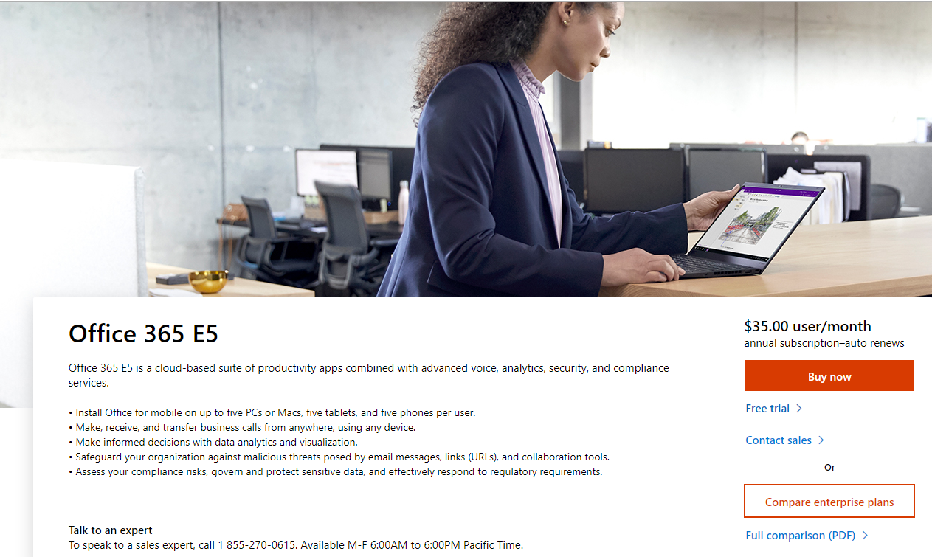
Guided LAB Demonstration

Slide 15
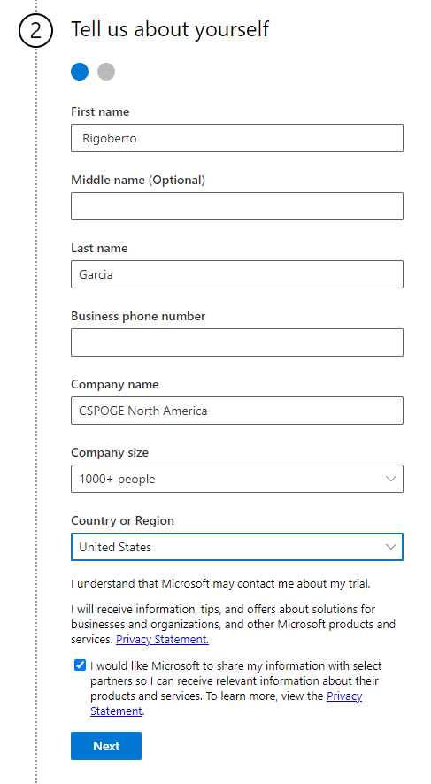
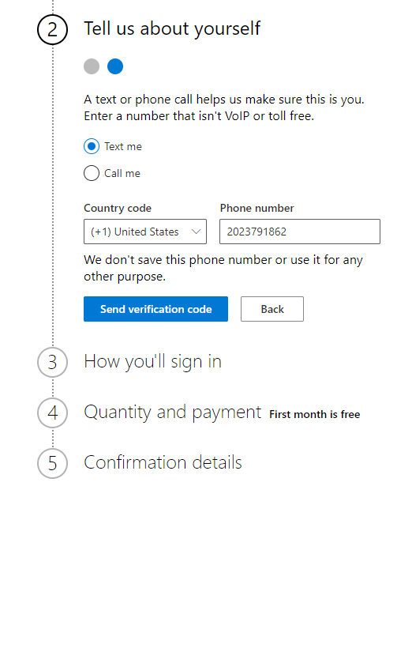
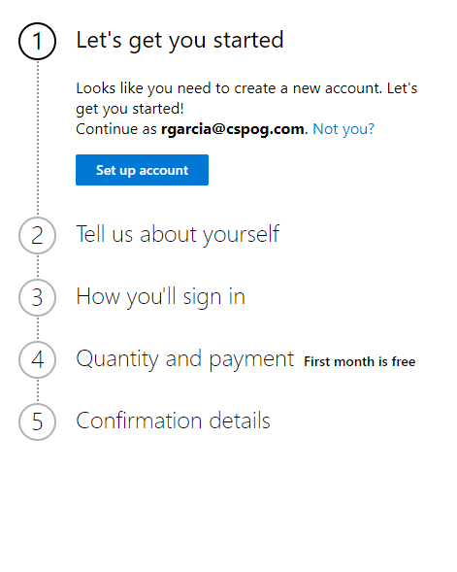
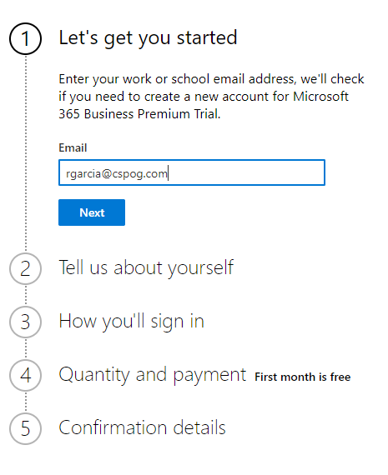
Creating a tenant account

Slide 16

Azure Virtual Desktop
Lesson 2

Slide 17

Lesson objectives
At the end of this module, you should be able to:
Describe Azure Virtual Desktop and how it works
Decide whether Azure Virtual Desktop is a good choice for your organization

Slide 18
Scenario
Suppose you work at large federal government agency that uses Microsoft 365. Your organization has 250+ employees that may use different devices depending on where they're working. During some periods of heavy demand, your agency hires short-term consultants to be able to meet customer needs and internal agency deadlines. Software that is utilize to manage the agency services must be updated every year due to regulatory updated. On a yearly basis your agency decides to update the core critical processed, however, it leaves some legacy features which have been customized and cannot be upgraded this creates a challenge to support.

Slide 19

Based on this scenario what should your goals be?
Notes:
You'd like to simplify management of the software your organization uses. You also need to support a flexible workforce by providing a secure, consistent, and performant experience to the apps they need to do their work. You want to see how Azure Virtual Desktop can help your organization.

Slide 20
What is Azure Virtual Desktop?
Provide the best user experience
Enhance security
Simplify management
Manage performance
Deploy multi-session Windows 10 and 11
Bring your licenses
Save on compute costs
Notes:
You'd like to simplify management of the software your organization uses. You also need to support a flexible workforce by providing a secure, consistent, and performant experience to the apps they need to do their work. You want to see how Azure Virtual Desktop can help your organization.
Azure Virtual Desktop on Microsoft Azure is a desktop and app virtualization service that runs on the cloud. Azure Virtual Desktop works across devices, like Windows, Mac, iOS, Android, and Linux, with apps that you can use to access remote desktops and apps. You can also use most modern browsers to access Azure Virtual Desktop-hosted experiences.
Provide the best user experience
Users have the freedom to connect to Azure Virtual Desktop with any device over the internet. They use an Azure Virtual Desktop client to connect to their published Windows desktop and applications. This client could either be a native application on the device or the Azure Virtual Desktop HTML5 web client.
You can make sure your session host virtual machines (VMs) run near apps and services that connect to your datacenter or the cloud. So users stay productive and don't encounter long load times.
User sign-in to Azure Virtual Desktop is extremely fast because user profiles are containerized by using FSLogix. At sign-in, the user profile container is dynamically attached to the computing environment. The user profile is immediately available and appears in the system exactly like a native user profile.
You can provide individual ownership through personal (persistent) desktops. For example, you may want to provide personal remote desktops for members of an engineering team. They'd be able to add or remove programs without impacting other users on that remote desktop.
Enhance security
Azure Virtual Desktop provides centralized security management for user's desktops with Azure Active Directory (Azure AD). You can enable multifactor authentication to secure user sign-ins. You can also secure access to data by assigning granular role-based access controls to users.
With Azure Virtual Desktop, the data and apps are separated from the local hardware and runs them instead on a remote server. So the risk of confidential data being left on a personal device is reduced.
User sessions are isolated in both single and multi-session environments.
Azure Virtual Desktop also improves security by using reverse connect technology, which is a more secure connection type than the Remote Desktop Protocol. We don't open inbound ports to the session host VMs.
Simplify management
Azure Virtual Desktop is an Azure service that will be familiar to Azure administrators. You use Azure Active Directory and role-based access controls to manage access to resources. Also with Azure, you get tools to automate VM deployments, manage VM updates, and provide disaster recovery. As with other Azure services, Azure Virtual Desktop uses Azure Monitor for monitoring and alerts. This lets admins identify issues through a single interface.
Manage performance
Azure Virtual Desktop gives you options to load balance users on your VM host pools. Host pools are collections of VMs with the same configuration assigned to multiple users. For the best performance, you can configure load balancing to occur as users sign in (breadth mode). With breadth mode, users are sequentially allocated across the host pool for your workload. To save costs, you can configure your VMs for depth mode load balancing where users are fully allocated on one VM before moving to the next. Azure Virtual Desktop provides tools to automatically provision additional VMs when incoming demand exceeds a specified threshold.
Deploy multi-session Windows 10
Azure Virtual Desktop lets you use Windows 10 Enterprise multi-session, the only Windows client-based operating system that enables multiple concurrent users on a single virtual machine (VM). Azure Virtual Desktop also provides a more consistent experience with broader application support compared to Windows Server-based operating systems.
Bring your licenses
Azure Virtual Desktop is available to you at no additional cost if you have an eligible Microsoft 365 license. Just pay for the Azure resources used by Azure Virtual Desktop.
Bring your eligible Windows or Microsoft 365 license to get Windows 10 Enterprise and Windows 7 Enterprise desktops and apps at no additional cost.
If you're an eligible Microsoft Remote Desktop Services (RDS) Client Access License (CAL) customer, Windows Server Remote Desktop Services desktops and apps are available at no additional cost.
Save on compute costs
Buy one-year or three-year Azure Reserved Virtual Machine Instances to save you up to 72 percent versus pay-as-you-go pricing. You can pay for a reservation up front or monthly. Reservations provide a billing discount and don't affect the runtime state of your resources.

Slide 21
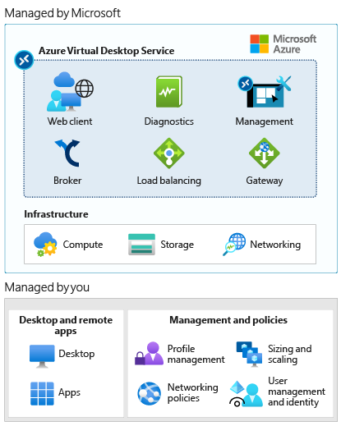
How does Azure Virtual Desktop work?
What's managed by Microsoft?
Web client
Diagnostics
Management
Broker
Load balancing
Gateway
Notes:
What Microsoft manages
Azure Virtual Desktop provides virtualization infrastructure as a managed service. Azure Virtual Desktop manages:
Web client - The Web Access service within Window Virtual Desktop lets users access virtual desktops and remote apps through an HTML5-compatible web browser like they would with a local PC—from anywhere and any device. You can secure Web Access by using multifactor authentication in Azure Active Directory (Azure AD).
Diagnostics - Remote Desktop Diagnostics is an event-based aggregator that marks each user or administrator action on the Azure Virtual Desktop deployment as a success or failure. Administrators can query the aggregation of events to identify failing components.
Management - Manage Azure Virtual Desktop configurations in the Azure portal. Manage and publish host pool resources. Azure Virtual Desktop also includes several extensibility components. Manage Azure Virtual Desktop by using Windows PowerShell or with the provided REST APIs, which also enable support from third-party tools.
Broker - The Connection Broker service manages user connections to virtual desktops and remote apps. It provides load balancing and reconnection to existing sessions.
Load balancing - Session host load balancing by depth-first or breadth-first. The broker decides how new incoming sessions are to be distributed across the virtual machines (VMs) in a host pool.
Gateway - The Remote Connection Gateway service connects remote users to Azure Virtual Desktop remote apps and desktops from any internet-connected device that can run an Azure Virtual Desktop client. The client connects to a Gateway that then orchestrates a connection from the VM back to the same gateway.
Window Virtual Desktop uses Azure infrastructure services for compute, storage, and networking.

Slide 22

What you manage
Desktop and remote apps
Desktop
App
Images
Notes:
Create application groups to group, publish, and assign access to remote apps or desktops.
Desktop - Remote Desktop application groups give users access to a full desktop. You can provide a desktop where the session host VM resources are shared or pooled. Or you can provide personal desktops to users that need to be able to add or remove programs without impacting other users.
App - RemoteApp applications groups provide users access to the applications you individually publish to the application group. You can create multiple RemoteApp app groups to accommodate different user scenarios. Use RemoteApp to virtualize an app that runs on a legacy OS or one that needs secured access to corporate resources.
Images - When you configure session hosts for application groups, you have your choice of images. Use a recommended image like Windows 10 Enterprise multi-session + Office 365. Or choose another image in your gallery or an image provided by Microsoft or other publishers. You can also use your own image built through Hyper-V or on an Azure VM.

Slide 23
Management and policies
Profile management
Sizing and scaling
Networking policies
User management and identity
Notes:
Profile management - Configure FSLogix with a storage solution like Azure Files to containerize user profiles and provide a fast and stateful experience for users.
Sizing and scaling - Specify session host VM sizes including GPU-enabled VMs. Specify depth-first or breadth-first load balancing when you create a host pool. Configure automation policies for scaling.
Networking policies - Define network topology to access virtual desktop and virtual apps from the intranet or internet based on organizational policy. Connect your Azure Virtual Desktop vNET to your on-premises network by using a virtual private network. Or use Azure ExpressRoute to extend your on-premises networks into the Microsoft cloud platform over a private connection.
User management and identity - Use Azure AD and role-based access controls to manage user access to resources. Take advantage of Azure Active Directory security features, such as Conditional Access, multifactor authentication, and the Intelligent Security Graph. Azure Virtual Desktop requires Active Directory Domain Services (AD DS). Domain-join session host VMs to this AD DS. Sync AD DS with Azure AD so users are associated between the two.

Slide 24

Infrastructure and system requirements

Slide 25
Infrastructure
Custom hybrid environments:
An Azure Active Directory organization
A domain controller that's synced with Azure Active Directory. You can configure this with one of the following:
Azure AD Connect
Azure Active Directory Domain Services (Azure AD DS)
An Azure subscription that contains a virtual network that either contains or is connected to the Windows Server Active Directory or Active Directory Domain Services
The cloud organizations:
An Azure Active Directory organization
Azure AD DS
An Azure subscription that contains a virtual network that either contains or is connected to the Active Directory Domain Services
Azure VMs for Azure Virtual Desktop must be:
Standard domain-joined, Hybrid AD-joined, or Azure AD-joined.
Running one of the supported OS images.

Slide 26
Supported Remote Desktop clients
The following Remote Desktop clients support Azure Virtual Desktop:
Windows Desktop
Web
macOS
iOS
Android (Preview)
Linux

Slide 27
Supported VM OS images
Azure Virtual Desktop supports the following x64 operating system images:
Windows 11
Windows 10 Enterprise multi-session, version 1809 or later
Windows 10 Enterprise, version 1809 or later
Windows 7 Enterprise
Windows Server 2022
Windows Server 2019
Windows Server 2016
Windows Server 2012 R2
Notes:
Supported VM OS images
Azure Virtual Desktop supports the following x64 operating system images:
Windows 10 Enterprise multi-session, version 1809 or later
Windows 10 Enterprise, version 1809 or later
Windows 7 Enterprise
Windows Server 2019
Windows Server 2016
Windows Server 2012 R2
Azure Virtual Desktop doesn't support x86 (32-bit), Windows 10 Enterprise N, or Windows 10 Enterprise KN operating system images. Windows 7 also doesn't support any VHD or VHDX-based profile solutions hosted on managed Azure Storage due to a sector size limitation.

Slide 28

Set up process
Prepare
In the Prepare module, we'll discuss the following steps to complete before you deploy Azure Virtual Desktop:
Set up Azure Active Directory (Azure AD).
Integrate with Active Directory Domain Services.
Create Azure resources.
Assign administrator roles.
Assign licenses to Azure Virtual Desktop users.
Register the Desktop Virtualization provider with your subscription.
Notes:
Microsoft's Azure Virtual Desktop solution on Microsoft Azure is a fully managed desktop virtualization solution.
As you progress through the Azure Virtual Desktop training, you'll notice that the setup process abstracts many of the infrastructure roles you might have deployed for RDS in the past. Use the information in this learning path to Prepare > Deploy > Optimize your Azure Virtual Desktop environments.
The following table gives you an overview of the setup process and describes what's covered in the rest of the Azure Virtual Desktop modules.

Slide 29

Deploy
In the Deploy module, we'll walk through the steps to:
Create an Azure Virtual Desktop host pool and workspace.
Make a desktop and apps available to users by using application groups.
Customize the workspace.
Connect to the workspace by using the Azure Virtual Desktop client.

Slide 30
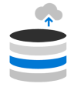
Optimize
In the Optimize module, we'll walk through the steps to:
Set up roaming and stateful user profiles by using Azure File Storage and FSLogix.
Configure Azure File Sync to sync on-premises files or user profile data to Azure Storage.
Scale session hosts by using the scaling tool built on Azure Automation and Azure Logic Apps.

Slide 31
Azure Virtual Desktop Scenarios
Security and Regulation
Elastic workforce
- Financial services - Healthcare - Government
- Mergers and acquisitions - Short-term employees - Contractors and partners
Remote employees
Specialized workloads
- Design and engineering - Legacy apps - Software development and test
- BYOD and mobile - Call centers - Branch workers
Notes:
Now that you know what Azure Virtual Desktop is, let's discuss the scenarios best suited for Azure Virtual Desktop. When to choose Azure Virtual Desktop
The following table describes business needs and applicable scenarios where Azure Virtual Desktop may be a good choice for an organization.
Security and regulation
Keep data and organizational resources safe while enabling the appropriate level of access by a variety of the organization's users. Leverage documentation and systems that support compliance with industry and local regulations. Elastic workforce
Scale Azure Virtual Desktop to provide access to services on demand.
Remote Employees
Meet employee-specific needs by allowing them to use their own device and be productive wherever they are.
Specialized workloads
Provide access to apps or desktops that may need to run with specialized or older software.

Slide 32
When not to choose Azure Virtual Desktop
Azure Virtual Desktop isn't suited for offline scenarios.
It runs on Azure in the cloud.
Users need to be online to connect and use Azure Virtual Desktop remote apps and desktops.

Slide 33
Is Azure Virtual Desktop the right choice?
Let's reconsider our federal agency scenario from the first unit. The key points from that scenario were:
Users need to be able to work from any device from anywhere.
During agency heavy season requires, short-term consultants to be and they will need access in order to meet customer needs to reach regulatory deadlines.
Agency software changes from year to year and the agency has some legacy applications that are a challenge to support.
As the administrator you will need to provide a secure, consistent, and performant experience to the apps employees need to do their work.
Azure Virtual Desktop can support all these scenarios and would be a good choice for this organization.
Notes:
Let's reconsider our federal agency scenario from the first unit. The key points from that scenario were:
Users need to be able to work from any device from anywhere.
During agency heavy season requires, short-term consultants to be and they will need access in order to meet customer needs to reach regulatory deadlines.
Agency software changes from year to year and the agency has some legacy applications that are a challenge to support.
As the administrator you will need to provide a secure, consistent, and performant experience to the apps employees need to do their work.
Azure Virtual Desktop can support all these scenarios and would be a good choice for this organization.

Slide 34
Knowledge check
What is Azure Virtual Desktop?
A Windows Server role that provides desktop and app virtualization
An Azure service that provides desktop and app virtualization service in the cloud
A service that provides desktop virtualization on-premises
What do you need to configure when you set up an Azure Virtual Desktop?
Remote Desktop Session Host (RD Session Host)
Web client
Pooled or personal session hosts
When could Azure Virtual Desktop be a good choice for an organization?
Users need flexibility to work remotely with their personal device
Users need to be able to work offline
Organization wants full end-to-end control of the desktop virtualization environment
Notes:
B
C
A

Slide 35

Summary
You learned:
Benefits of Azure Virtual Desktop
What Microsoft manages and what you manage
Infrastructure and system requirements
When to choose Azure Virtual Desktop
Notes:
In this module you learned about Azure Virtual Desktop, the desktop and app virtualization service in Microsoft Azure. Specifically you learned:
Benefits of Azure Virtual Desktop
What Microsoft manages and what you manage
Infrastructure and system requirements
When to choose Azure Virtual Desktop
Continue this learning path to learn about each aspect of the three-step process to Prepare > Deploy > Optimize your Azure Virtual Desktop environments.

Slide 36

Windows 365 Business Cloud PC
Stream to any device

Slide 37
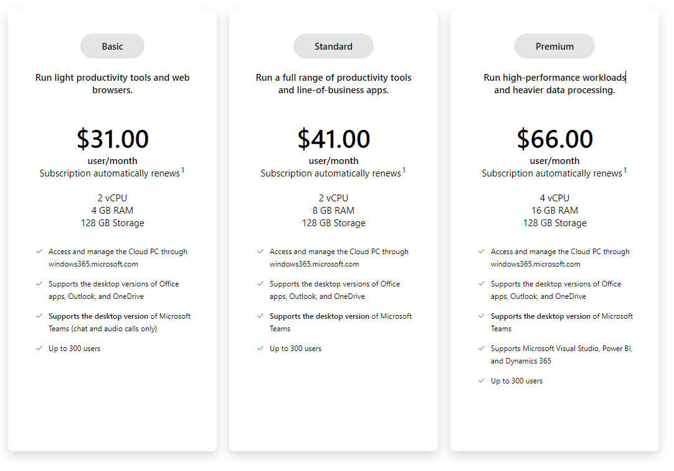
Business

Slide 38
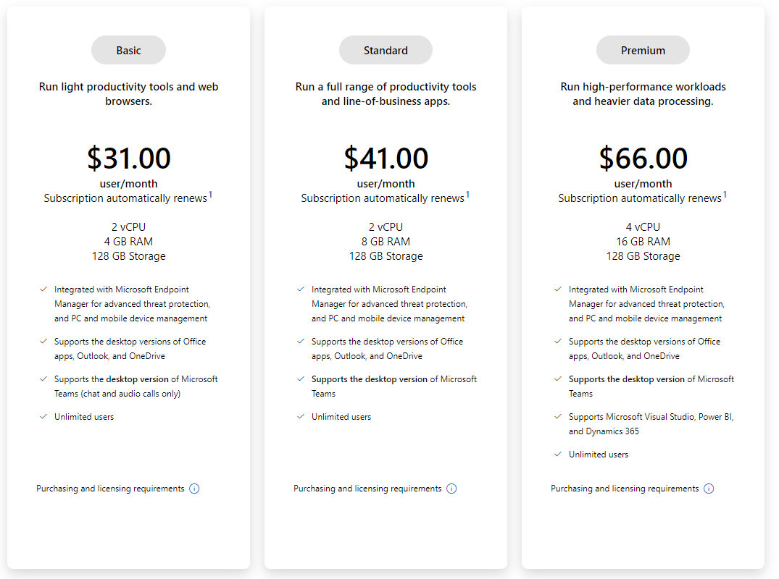
Enterprise

Slide 39
What is a Cloud PC?
Cloud PC is a highly available
optimized, and
scalable virtual machine

Slide 40
Windows 365 Business
Windows 365 Cloud PC
Hybrid Windows for a hybrid world
Your Windows in the cloud
Work anywhere
Simplify management
Access all your resources
Increase productivity
Minimize risk
Manage costs
Streamline IT
Scale for your needs
Notes:
Hybrid Windows for a hybrid world
Windows 365 combines the power and security of the cloud with the versatility and simplicity of the PC. From contractors and interns to software developers and industrial designers, Windows 365 enables a variety of new scenarios for the new world of work.
Your Windows in the cloud
Securely stream your Windows experience—including your personalized apps, content, and settings—from the Microsoft cloud to any device with your Windows 365 Cloud PC

Slide 41

Windows 365 Enterprise
Benefits
Rely on the Microsoft cloud
Ensure business continuity
Scale as needed
Easily deploy and manage
Protect your data
Increase security and compliance
Features
Support remote and distributed workforces
Bring your own PC
Onboard temporary employees

Slide 42
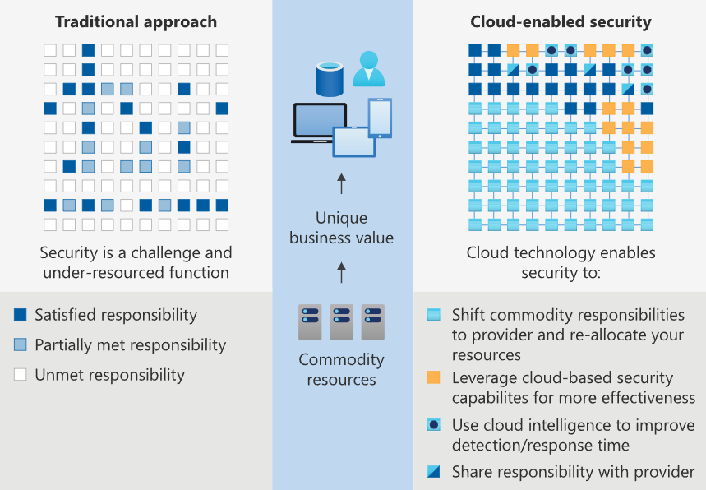
Cloud security advantages
cloud-enabled approach
leverage cloud-based security
Improve cloud intelligence
Notes:
Cloud security advantages
The cloud offers significant advantages for solving long standing information security challenges. In an on-premises environment, organizations likely have unmet responsibilities and limited resources available to invest in security, which creates an environment where attackers are able to exploit vulnerabilities at all layers.
The following diagram shows a traditional approach where many security responsibilities are unmet due to limited resources. In the cloud-enabled approach, you are able to shift day to day security responsibilities to your cloud provider and reallocate your resources.
In the cloud-enabled approach, you are also able to leverage cloud-based security capabilities for more effectiveness and use cloud intelligence to improve your threat detection and response time. By shifting responsibilities to the cloud provider, organizations can get more security coverage, which enables them to reallocate security resources and budget to other business priorities.
Next steps

Slide 43
Windows 10 Enterprise

Slide 44
Windows 10 Enterprise
Threat protection
Identity access
Information Protection
Notes:
Threat protection
Windows 10 threat protection includes next-generation malware and hacking defense to help protect against threats, including zero-day attacks. It provides a hardened platform that can help prevent encounters, isolate threats, and prevent the execution of malicious apps and content. Windows 10 can detect and respond to the most advanced threats and automatically remediate them.
Identity access
Windows 10 protects user identities against pass-the-hash and pass-the-ticket attacks by helping you move to a world without passwords. Windows Hello is a biometric authentication tool that strengthens authentication and helps guard against potential spoofing.
Information Protection
Windows 10 makes it easy to protect data – whether that data is at rest or in use. Windows Information Protection helps protect sensitive information against leaks. When you combine Windows 10 with Azure Information Protection and Microsoft 365, you get a sophisticated solution that meets the highest requirements for data loss prevention with minimal input.

Slide 45
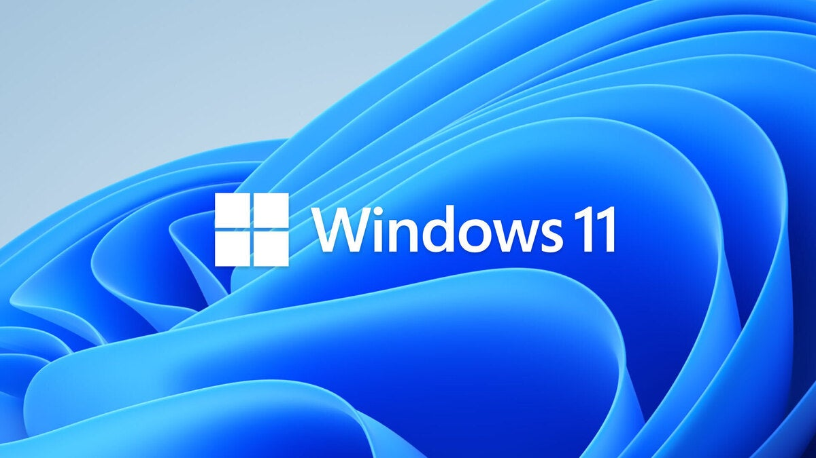
Windows 11 enterprise
Notes:
This module examines the concepts and principles of the Zero Trust security model, as well as how Microsoft 365 supports it, and how your organization can implement it.

Slide 46
What is Microsoft Windows 11 Zero Trust?
Lesson Objectives
By the end of this module, you will be able to:
Describe the Zero Trust approach to security in Microsoft 365
Describe the principles and components of the Zero Trust security model
Describe the five steps to implementing a Zero Trust security model in your organization
Explain Microsoft's story and strategy around Zero Trust networking
After Completing the Module
Describe the Zero Trust approach to security in Microsoft 365.
Describe the principles and components of the Zero Trust security model.
Describe the five steps to implementing a Zero Trust security model in your organization.
Explain Microsoft's story and strategy around Zero Trust networking.
Notes:
Microsoft Zero Trust-ready operating architecture is designed to protect an organization. The shift to cloud technology is ofter riddle with hidden corners. Zero Trust services create verifiable and certified security verifications services that are built-in and turned on by default. While the acceleration of digital transformation has dramatically improved our ability to be productive while working remotely, it has also introduced new security challenges. A recent study commissioned by Microsoft 2021 found that seventy-five percent of all security decision-makers at the executive level feel that a shift to cloud technology is in their path ahead. This is due in part to a shift in Remote work and the move to a hybrid work modern environment, which leaves their organization faced with added vulnerability to security threats. The study also revealed that eighty percent of all security executives feel that software alone is not enough protection from emerging threats, and nearly nine out of ten executives make the assertion that their systems are riddled with outdated hardware, leaves organizations more open to attacks and more modern hardware would help protect against future threats.

Slide 47
Introduction windows 11 zero trust
Today’s organizations need a new security model that effectively:
adapts to the complexity of the modern environment.
embraces the mobile workforce.
protects people, devices, apps, and data wherever they're located.
The questions we must ask as security practitioners or admins include:
How do we help people to have confidence in the security of their devices, their data, and their actions online?
How do we protect people, so they have peace of mind and are empowered to innovate and grow their future?
How do we foster trust in a Zero Trust world?
Notes:
Today’s organizations need a new security model that effectively:
adapts to the complexity of the modern environment.
embraces the mobile workforce.
protects people, devices, apps, and data wherever they're located.
The security model to support this modern reality is called Zero Trust. If there’s one thing that recent events have shown, it’s that security isn’t getting any easier. Recent high-profile breach activity has underscored the growing sophistication of today’s threat actors and the complexity of managing business risk in an increasingly connected world. It’s a struggle for organizations of every size and for the public and private sector alike. As organizations move into this next phase of digital transformation, with technology increasingly woven into our most basic human activities, the questions they must ask themselves as security defenders include:
How do we help people to have confidence in the security of their devices, their data, and their actions online?
How do we protect people, so they have peace of mind and are empowered to innovate and grow their future?
How do we foster trust in a Zero Trust world?
As security practitioners ourselves, we understand that , Microsoft is a passionate proponent of the Zero Trust mindset, encompassing all types of threats—both outside in and inside out. Microsoft believes the right approach is to address security, compliance, identity, and device management as an interdependent whole and to extend protection to all data, devices, identities, platforms, and clouds—whether those things are from Microsoft or not.

Slide 48

principles and components of the Zero Trust model
Zero Trust principles
Verify explicitly.
Use least privileged access.
Assume breach.
Zero Trust components
Identities.
Devices.
Applications. .
Data.
Infrastructure.
Network.
Notes:
Instead of assuming everything behind the corporate firewall is safe, the Zero Trust model assumes every request is a potential breach. As such, every request must be verified as though it originates from an open network. Regardless of where the request originates or what resource it accesses, Zero Trust teaches us to “never trust, always verify.” Every access request is fully authenticated, authorized, and encrypted before granting access. Microsegmentation and least privileged access principles are applied to minimize lateral movement. Rich intelligence and analytics are used to detect and respond to anomalies in real time.
Zero Trust components
The Zero Trust model consists of the following primary components:
Identities. Verify and secure each identity with strong authentication across your entire digital estate.
Devices. Gain visibility into devices accessing the network. Ensure compliance and health status before granting access.
Applications. Discover shadow IT applications, ensure appropriate in-app permissions and gate access based on real-time analytics, and monitor and control user actions.
Data. Move from perimeter-based data protection to data-driven protection. Use intelligence to classify and label data. Encrypt and restrict access based on organizational policies.
Infrastructure. Use telemetry to detect attacks and anomalies, automatically block and flag risky behavior, and employ least privilege access principles.
Network. Ensure devices and users are not trusted just because they are on an internal network. Encrypt all internal communications, limit access by policy, and employ microsegmentation and real-time threat detection.

Slide 49
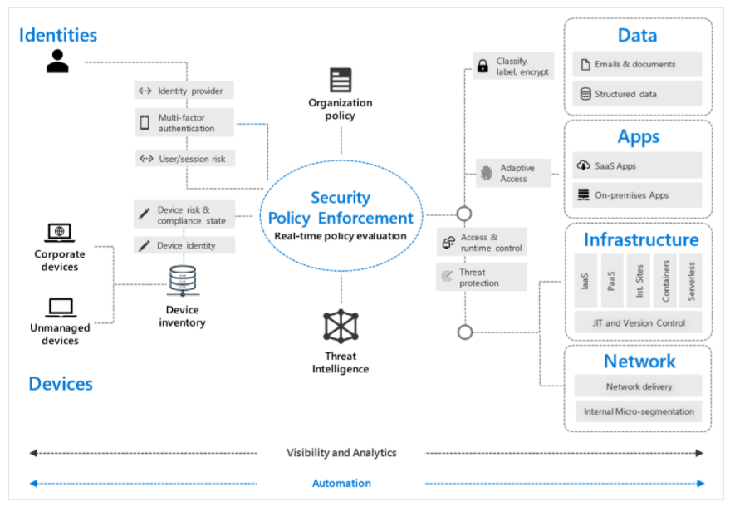
Zero Trust security
Notes:
Additional reading. For more information on Zero Trust security, see the Zero Trust maturity model.

Slide 50
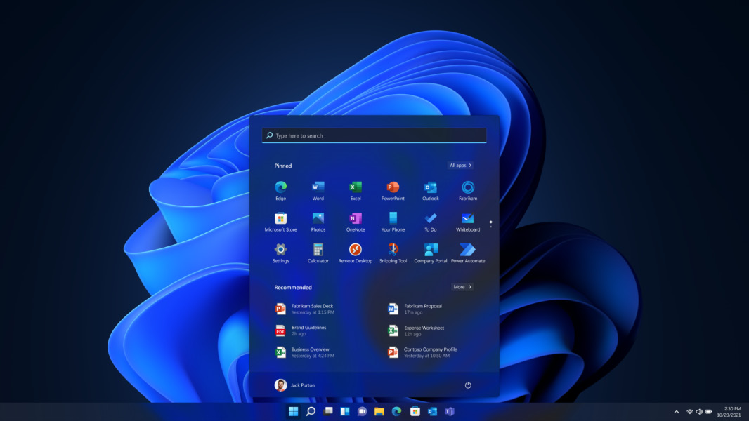
Windows 11 Productivity Score
Figure 3: Windows 11
Productivity Score provides the following:
Metrics to help you see where you are on your digital transformation journey
Insights about your data to help you identify opportunities to improve productivity and satisfaction in your organization
Actions you can take to help your organization use Microsoft 365 products efficiently

Slide 51
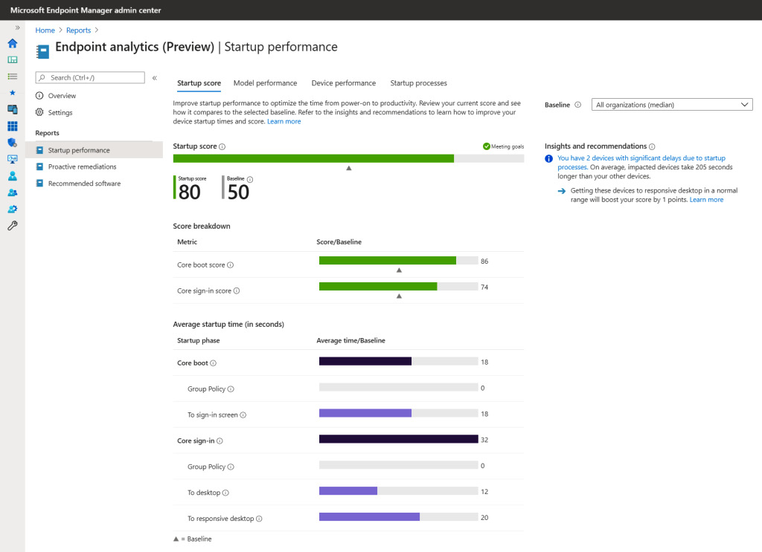
Windows 11 Endpoint Analytics
Notes:
Endpoint Analytics
Endpoint Analytics is a service used to ensure your MEM deployment's consistent performance and is part of the Productivity Score. Everything that is collected comes from measurements of how your business is working. For example, Endpoint Analytics gives you insights into the boot time of your physical device, logon duration, and application startup time. The insights enable IT admins to reduce support costs by adding capabilities to solve issues in their environment proactively. This can all happen automatically without any involvement of the IT admin
Your end-to-end experience can be dramatically improved by Endpoint Analytics and the benefits it brings. Another huge benefit is that all service costs are included; unlike the case with Azure Monitor, there is no need to pay for storage retention!

Slide 52
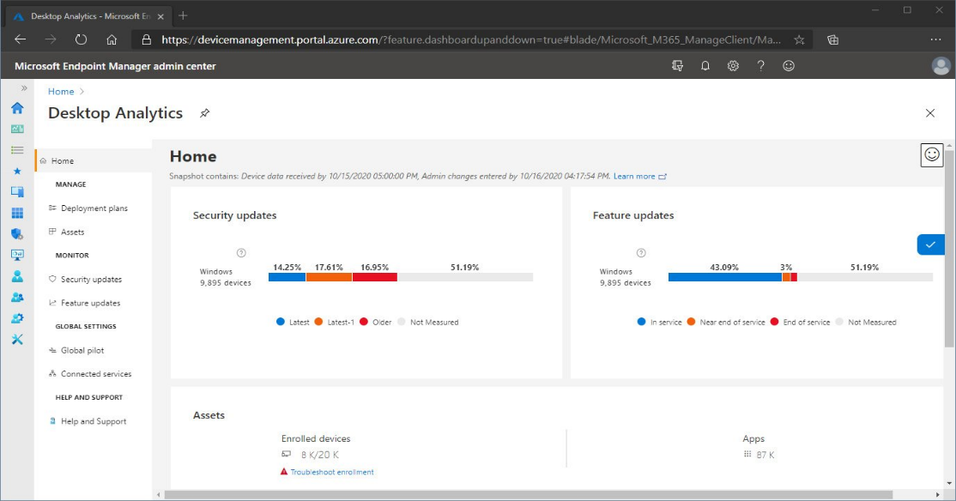
Desktop Analytics
Desktop Analytics with Configuration Manager:
Create an inventory of apps running in your organization.
Assess app compatibility with the latest Windows 10 feature updates.
Identify compatibility issues and receive mitigation suggestions based on cloud-enabled data insights.
Create pilot groups representing the entire application and driver estate across a minimal set of devices.
Deploy Windows 10 to pilot and production-managed devices.
Notes:
Desktop Analytics is an important part of the full MEM service; it is cloud-based and integrates with Configuration Manager. The service also provides different levels of insights and intelligence for IT administrators to make proactive decisions about the update readiness of your Windows 10 endpoints. The service combines data from your business with data aggregated from millions of devices connected to Microsoft cloud services.
Here is a list of the different benefits of Desktop Analytics with Configuration Manager:
Create an inventory of apps running in your organization.
Assess app compatibility with the latest Windows 10 feature updates.
Identify compatibility issues and receive mitigation suggestions based on cloud-enabled data insights.
Create pilot groups representing the entire application and driver estate across a minimal set of devices.
Deploy Windows 10 to pilot and production-managed devices.
Here is an example screenshot of how security and feature updates come together in a single, unified experience in Desktop Analytics:
Figure 6 Desktop Analytics – management console
Now that we have talked about all the different enhancements to monitor and analyze your endpoints, we're going to talk about the different Microsoft 365 services that you can use within your physical and cloud-managed desktops.

Slide 53
What are the features of Microsoft Teams?
Features:
Communicate through chat, meetings, and calls
Integrated Microsoft 365 apps and windows 11
Custom Workplace and achieve more
Connected across devices
Microsoft Edge
Universal Print

Slide 54

Knowledge check
Which of the following items is an underlying principle that's part of the foundation of the Zero Trust model?
Implicit trust
Use most privileged access
Assume breach
What are the main benefits of using MEM?
MEM prevents remote devices and apps from accessing an organization's resources.
MEM ensures that an organization no longer needs credentials to access and share company data.
MEM helps keep an organization's cloud and on-premises devices, apps, and data secure.
MEM helps keep an organization's cloud devices, apps, and data secure.
What are the main differences between Windows 365 Cloud PC and AVD?
Windows 365 Cloud PC is designed for simplicity and AVD for flexibility.
Windows 365 Cloud PC has a fixed-price cost model and AVD is consumption-based.
Microsoft 365 has a fixed-price cost model and AVD is consumption-based.
Microsoft 365 is designed for simplicity and AVD for flexibility.
Notes:
C

Slide 55

Module Summary
What you learned:
You learned about all the different Microsoft 365 services and
Azure services you might use in your day job or as part of your journey to using MEM to simplify the management overhead of your environment.
This chapter mainly intended to provide context for the later chapters in the book;
We are now switching gears and taking you on the journey of unified endpoint management with MEM.
Notes:
In Chapter One, we covered several components associated with Microsoft Endpoint Management. You learned about all the different Microsoft 365 services and Azure services you might use in your day job or as part of your journey to using MEM to simplify the management overhead of your environment.
This chapter mainly intended to provide context for the later chapters in the book; we are now switching gears and taking you on the journey of unified endpoint management with MEM.

Slide 56

Labs

